Slide 1
Regrets and Desires
25. Wish and Hope

Slide 2
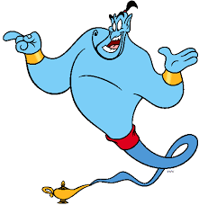
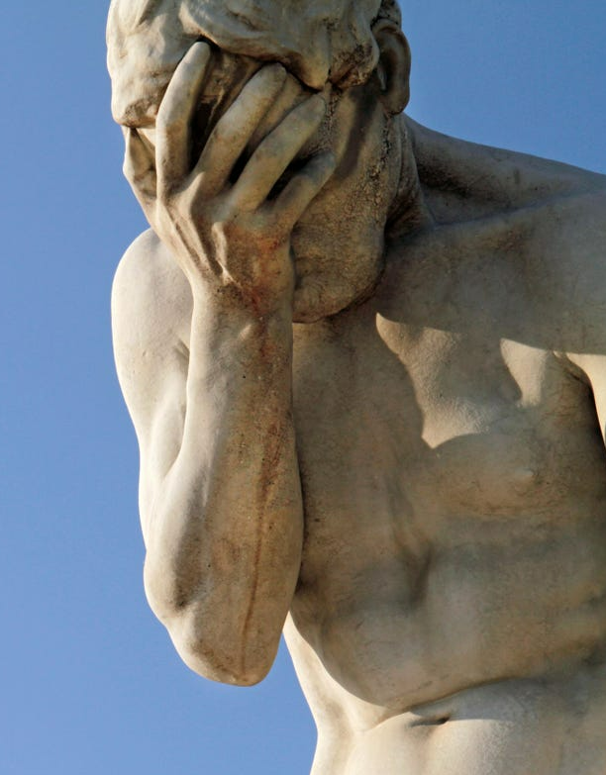
Regrets and Desires
What are some common regrets people have?
What are some common desires?

Slide 3
Wish
We use wish to express regret that things are not the way we would like them to be.
We can use wish to talk about the past, present, or future.
The word that is optional in sentences with wish.
We use wish + would / could + base form of the verb when we make a wish about the future or complain about a present situation.
I wish (that) he would invest in my business.
I wish (that) I could find a business partner.
Notes:
What do you wish you could do next weekend?

Slide 4
Complete with an appropriate verb
I wish I ________ to Japan next year to experience its culture.
I wish my boss ________ my hard work and give me a promotion.
I wish I ________ fluent English so I could communicate with locals during my trip.
I wish my car ________ every other week.
I wish I ________ a hobby that aligns with my schedule.
I wish my neighbor ________ the noise at night so I could sleep peacefully.
I wish I ________ so I wouldn’t have to pay for flights.
I wish my coworker ________ the changes and follow the instructions.
I wish I ________ whatever I want without worrying about allergies.
I wish I ________ more time with my loved ones.
Notes:
I wish I could travel to Japan next year to experience its culture.
I wish my boss would appreciate my hard work and give me a promotion.
I wish I could speak fluent English so I could communicate with locals during my trip.
I wish my car would stop breaking down every other week.
I wish I could find a hobby that aligns with my schedule.
I wish my neighbor would keep the noise down at night so I could sleep peacefully.
I wish I could teleport so I wouldn’t have to pay for flights.
I wish my coworker would understand the changes and follow my instructions.
I wish I could eat whatever I want without worrying about allergies.
I wish I could spend more time with my loved ones.

Slide 5
Wish + past simple
We use wish + Past Simple when we want to show that we are sorry about a present situation.
I wish (that) I had a better job.
We wish (that) we didn’t work so late.
In formal English, we usually use the word were for all subjects.
I wish (that) I were rich. (Not: I wish I was rich.)
She wishes (that) she were younger. (Not: She wishes she was younger.)

Slide 6
Bad present situation and wishes
Example: I don’t have free time. I want a hobby = I wish I had more time for my own interests.
I get very nervous when I present before an audience.
I don’t have enough savings for an emergency.
I am not very close with my family.
The weather is unbearably hot.
I am a workaholic.
I have problems reading out loud.
I don’t have a big network of like-minded professionals.
I procrastinate a lot.
It is hard for me to exercise.
I want to travel, but I am scared of doing it alone.
Notes:
I wish I had better communication skills.
I wish I had more savings.
I wish I had a closer relationship.

Slide 7
Wish + past perfect
We use wish + Past Perfect Simple when we are sorry about something that happened or did not happen in the past.
I wish I had opened my own business when I had the chance. (But I didn’t.)
I wish I had not forgotten your birthday. (But I did.)

Slide 8
Match the sentences
I wish I had pursued my passion for music
I wish I had traveled more
I wish I had invested in the company
I wish I had spent time with my friends
I wish I had taken that job offer abroad;
I wish I had finished writing my book;
I wish I had taken more risks;
I wish I had listened to my intuition;
I wish I had apologized sooner;
I played it too safe.
when I was younger and had a band.
it would have been incredible to live somewhere else.
when it was just a start-up.
I knew something was wrong.
when I had time for adventures.
before they moved from this city.
now it is too late to say sorry.
now I don’t remember how I wanted it to go.
Notes:
B. I wish I had pursued my passion for music when I was younger and had a band.
F. I wish I had traveled more when I had time for adventures.
D. I wish I had invested in the company when it was just a start-up.
G. I wish I had spent time with my friends before they moved from this city.
C. I wish I had taken that job offer abroad; it would have been incredible to live somewhere else.
i. I wish I had finished writing my book; now I don’t remember how I wanted it to go.
A. I wish I had taken more risks; I played it too safe.
E. I wish I had listened to my intuition; I knew something was wrong.
H. I wish I had apologized sooner; now it is too late to say sorry.

Slide 9
Hope + present simple
We sometimes use hope to express wishes and desires.
We use hope + Present Simple to talk about things we would like to happen in the future.
Someone else or ourselves are doing the action.
We hope (that) you succeed in your new business.
John’s friends hope (that) he finds a job soon.
I hope (that) I don’t make a mistake with this software.

Slide 10
Hope something for the situation
Example: She has a test = I hope she passes her test.
We are late for the movie.
It is cloudy, and my clothes are outside.
I bought an expensive gift for my wife.
I bet my city’s team will win.
The reviews said the movie was okay.
My friend needs vacation.
The weather is not very nice today.
Notes:
I hope you can be on time.
I hope it doesn’t rain
I hope she likes it.
I hope they win.

Slide 11
Hope + infinitive
We also use hope + infinitive to talk about things we would like to do in the future.
The person is doing the action, not someone else.
They hope to open their own business soon.
I hope to find someone to invest in my software.

Slide 12
Complete with an appropriate infinitive (to+verb)
I hope ______ the answer soon.
You hope ______ the laundry before it rains.
Gabriel hopes ______ a delicious meal next time.
Monica hopes ______ too anxious when she visits the doctor.
Joel and Ross hope ______ successful entrepreneurs.
We hope ______ the lottery some day.
I hope ______ the world.
I hope ______ my English skills.
You and I hope ______ a new house.
The dog hopes ______ all day in the park.
Notes:
I hope to find the answer soon.
You hope to finish the laundry before it rains.
Gabriel hopes to prepare a delicious meal next time.
Monica hopes not to be too anxious when she visits the doctor.
Joel and Ross hope to become successful entrepreneurs.
We hope to win the lottery some day.
I hope to travel the world.
I hope to improve my English skills.
You and I hope to buy a new house.
The dog hopes to play all day in the park.

Slide 13
Hope, past
We use hoped + modal + base form of the verb to talk about things we are sorry did not happen in the past.
Susan hoped (that) she would enjoy working in an office, but she didn’t.
I hoped (that) I could find a job quickly, but I didn’t.
Notes:
Could, would, might

Slide 14
I hoped I would do it…
Example: I could not attend the concert. = I hoped I could go.
We did not solve the issue on time.
Lola did not pass the driving test.
Emma did not convince her boss to give her a raise.
Jane could not catch the train.
Elizabeth was not selected for the internship.
Catherine could not finish the marathon.
Her mom did not get a discount for the faulty item.
William could not eat anything at the restaurant due to his allergies.
I did not go to the conference.
We were absent.
Notes:
I hoped we would solve it.
I hoped she would pass it.
I hoped she would convince her.

Slide 15
Difference between wish and hope
Hope mainly expresses a desire that is possible or likely to happen.
Wish usually expresses a desire that is impossible or unlikely to happen.
My classmates ________________ our teacher postpones the exam.
I ________________ I finish this project on time.
Susan ________________ she were rich so she could buy a new car.
I ________________ I could speak French.
Mark ________________ he had remembered her birthday.
Notes:
Hope because Hope + present
Hope because Hope + present
Wishes because wish + past
Wish because wish + could + base form
Wishes because wish + had + participle

Slide 16
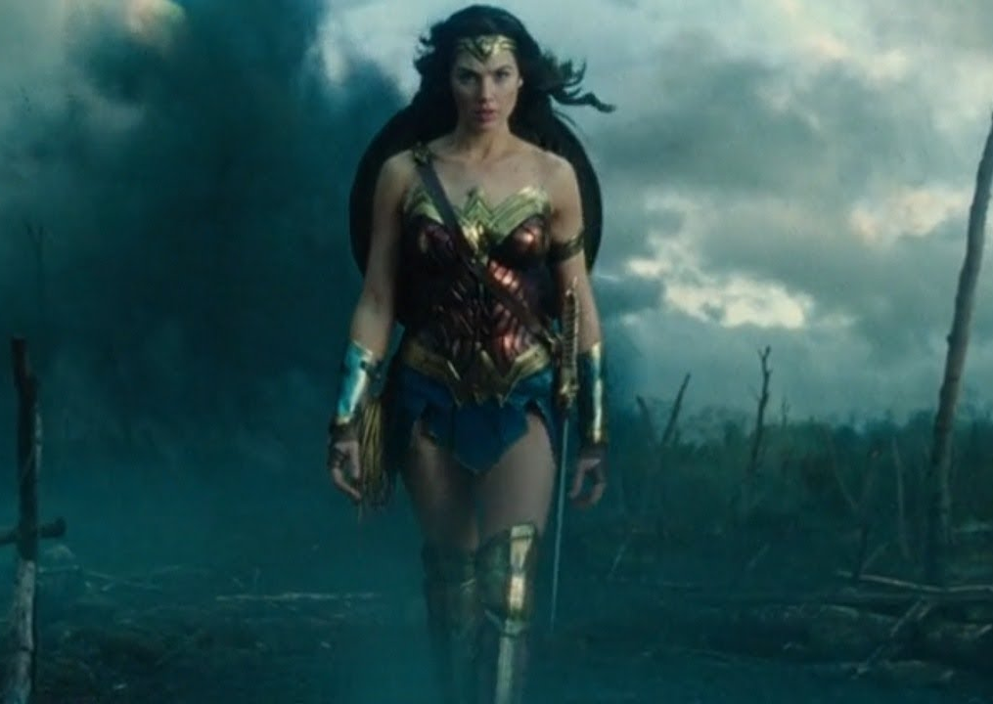
Kahoot time!
Go to kahoot.it
Enter the Game PIN.
Enter your name.
Get ready for battle.
Notes:
https://create.kahoot.it/details/209ddfb5-a575-4277-9982-41ea503aab49

